Slide 1

RAJASTHAN POLICE HACKATHON 1.0
Team name – Omb tech
Reg no – 386
Problem statement – ai/ar for police training

Slide 2
Content-
Introduction and problem statement
Solutions
Idea and approach
Benefits of AI in police training
Prototype
Services and Benefits

Slide 3

Problem Statement – AI/AR for Police Training
Overview of Current State of Police Training:
Traditional police training relies on static classroom settings and simulated scenarios.
These methods often lack realism, making it challenging for officers to adapt to dynamic, real-world situations.
The static nature of training may result in a gap between theoretical knowledge and practical application.

Slide 4

So what’s the solutions for that?
Let’s get solution for that….

Slide 5

Our idea and approach
Online Training Platform:
Provide a flexible and accessible online training platform for law enforcement professionals.
Officers can access training modules from anywhere, fostering continuous learning.
Implementing AI in online police training can offer several benefits, enhancing the efficiency and effectiveness of the training programs.

Slide 6
AI Trainer:
Introduce an AI-powered trainer for personalized and adaptive learning experiences.
Utilize AI to assess individual officer performance and tailor training content to specific needs.
Dynamic simulations and scenario-based exercises enhance decision-making skills.
Benefits-
Provide virtual fitness trainer which can guide a police learner any time

Slide 7
Chat Bot for Crime Data Analysis:
Implement a chat bot to analyse and interpret previous crime data.
Provide real-time insights on crime patterns, helping officers understand and anticipate local trends.
Enhance proactive policing by leveraging historical data for strategic decision-making.

Slide 8

Benefits of AI for Police Training-
.Improved decision-making skills
.Enhanced situational awareness
.Reduction in training time and costs
.Increased officer safety

Slide 9
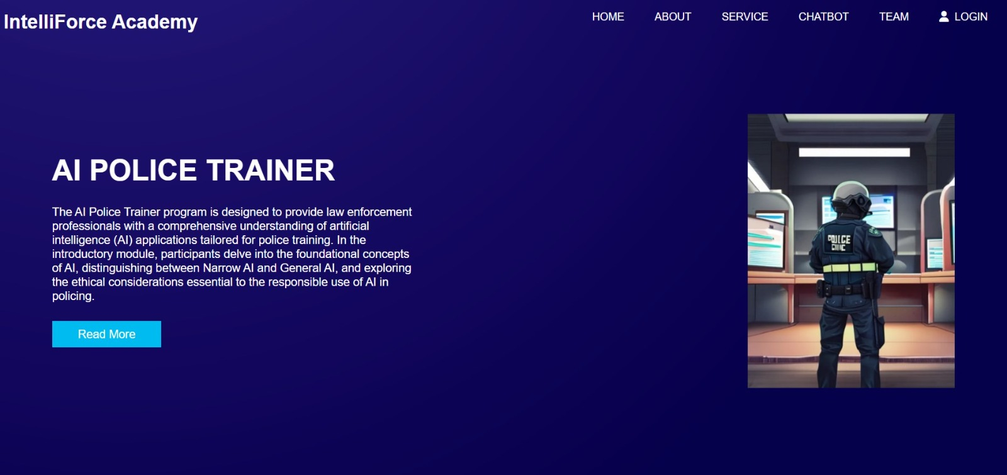
Our prototype-

Slide 10

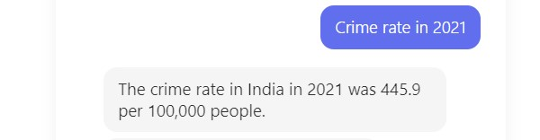

Slide 11
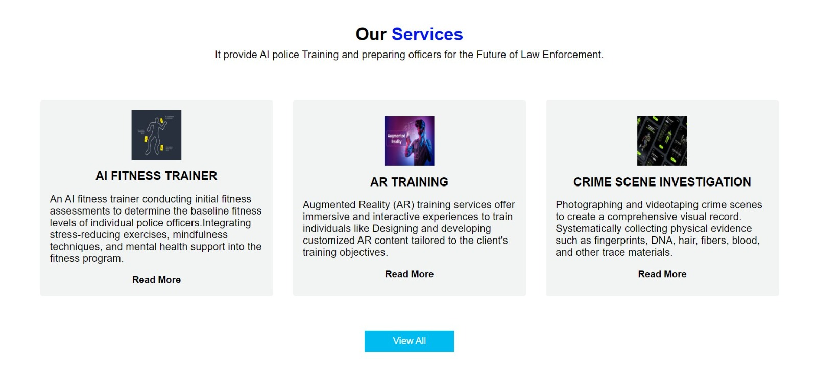

Slide 12
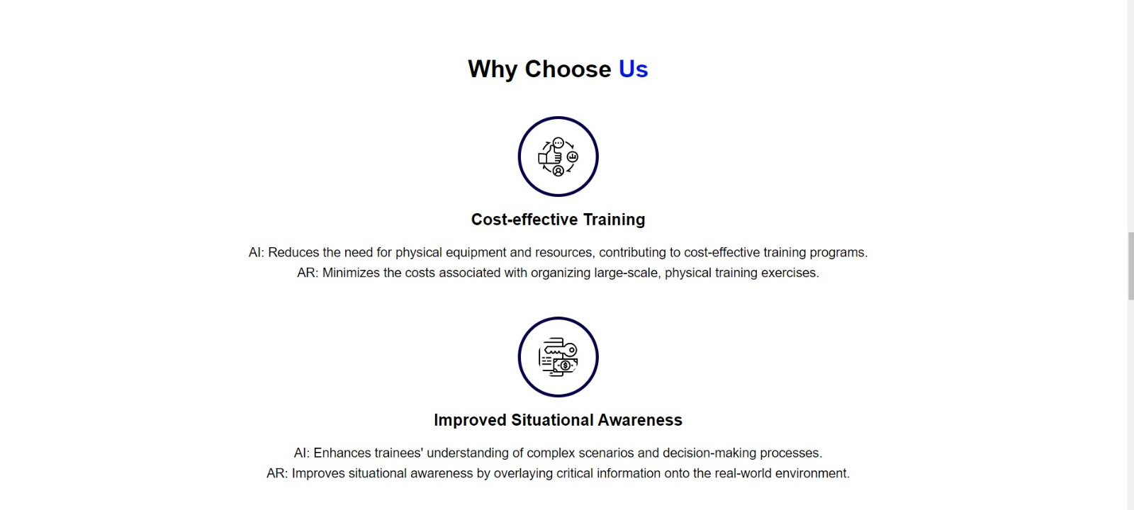

Slide 13
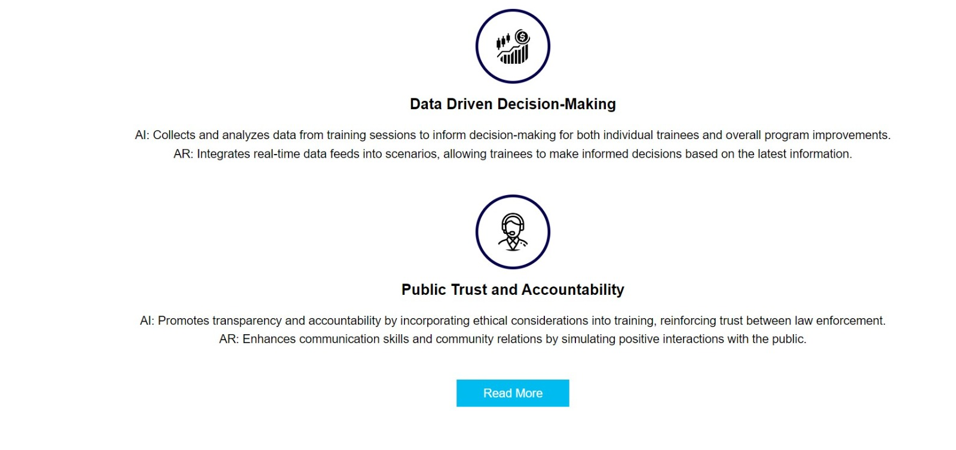

Slide 14
How it helps police for training?
Chat bot collect past crime data and give output for that.
Officers can take online training using AI
As nowdays AI is in boom so officers may take help of AI to solving crime cases.

Slide 15


